Slide 1


Title : Power-Loop-Generation
Theme: Renewable Energy

Slide 2

TABLE OF CONTENT
01
07
Introduction.
GTM - Strategy.
Analytical Calculations &
02
08
Problems.
Validation & Traction.
03
Solutions.
09
Core structure of product.
04
10
Target Market.
Market Competition.
05
11
Business Model.
Memories While Making.
06
Value Propagation &
Customer Segment.
12
Q&A.

Slide 3
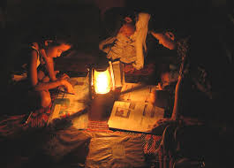
Problems:
Power cuts typically involves the reliability of the power supply .
Transmission of Power .
Economic Impact.
High Power Bills .
Middle Class Budget Issue .
How our Idea/Product fits to Renewable Energy:
Connecting the Power Sources to the Fans( the product which we use to construct in fans ) Fits to the theme of Renewable Energy.
Installing and Controlling Charge and Battery bank for the devices comes under Renewable Energy.
Not only Solar , Wind, Thermal power fits in the theme of Renewable Energy , the power which we are using for wasting - if we recycle that Power into sustainable development that also fits in Renewable Energy.

Slide 4
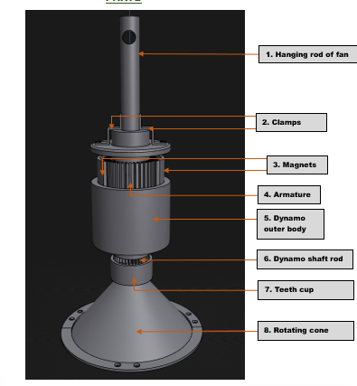
SOLUTIONS:
SOLUTIONS OF THE PROBLEMS:
By Installing our product in their Places , we will link our product with the special states with some power distribution APEPDCL,APCPDCL,APSPDCL,AVVNL,DOPAP,BESCOM,CSPDCL,IPCL,JVVNL,KSEB,etc – gives the subsidy in the power bills.
01
In the field of agriculture , some medical , some factories the purpose of our product can be customized what the customer is needed and with the help of Grid Technology the production of power from all the sources can be stored to the large scale .
02
We Rectify the consumed power into the Re-usable power, Which that power distributes to the same area where we place a batteries (single–User) , the power stored in batteries has the re-ability to re-generate power to the particular place .
03
04
To reduce the cost of power bills for middle class people ,our product is used in both large scale and single user model (no need of solar energy , wind energy).

Slide 5

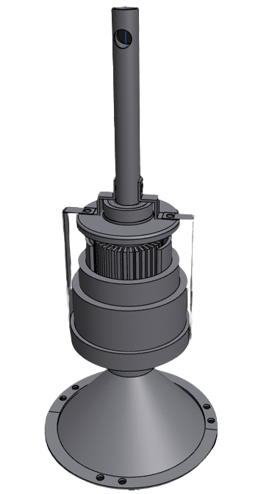
Target Market:
VISION: Our vision is to create a sustainable future by harnessing the power of re-using ,
Monitoring and Tracking of electricity. We envision a world where renewable energy sources are maximized, and every watt of electricity is efficiently utilized and recycled to minimize waste and environmental impact.
MISSION: Our mission is to revolutionize the way electricity is consumed and managed, by implementing innovative technologies and practices that promote the re-using ,Monitoring and Tracking of electricity. Through partnerships, education, and cutting-edge solutions, we aim to empower individuals, businesses, and communities to embrace sustainable energy practices, reduce their carbon footprint, and contribute to a cleaner, greener planet.

Slide 6
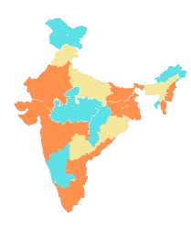

Traction:
Total Available Market (TAM)
OUR CLIENTS COME FROM EVERYWHERE
The Total Available Market (TAM) represents the entire potential demand for our product-service, reflecting the vast landscape of opportunities awaiting exploration and market capture.
Serviceable Available Market (SAM)
The Serviceable Available Market (SAM) represents the specific segment of the Total Available Market where our product or service can be realistically and effectively offered, defining the target audience for our strategic market – through this we are ready to make a Power generation .
Serviceable Obtainable Market (SOM)
Usage Of Power Based on States
The Serviceable Obtainable Market (SOM) signifies the realistic and achievable portion of the Serviceable Available Market where our business aims to capture the people who are using Fan’s - emphasizing our practical and strategic approach to the market .
High
Average
Low

Slide 7
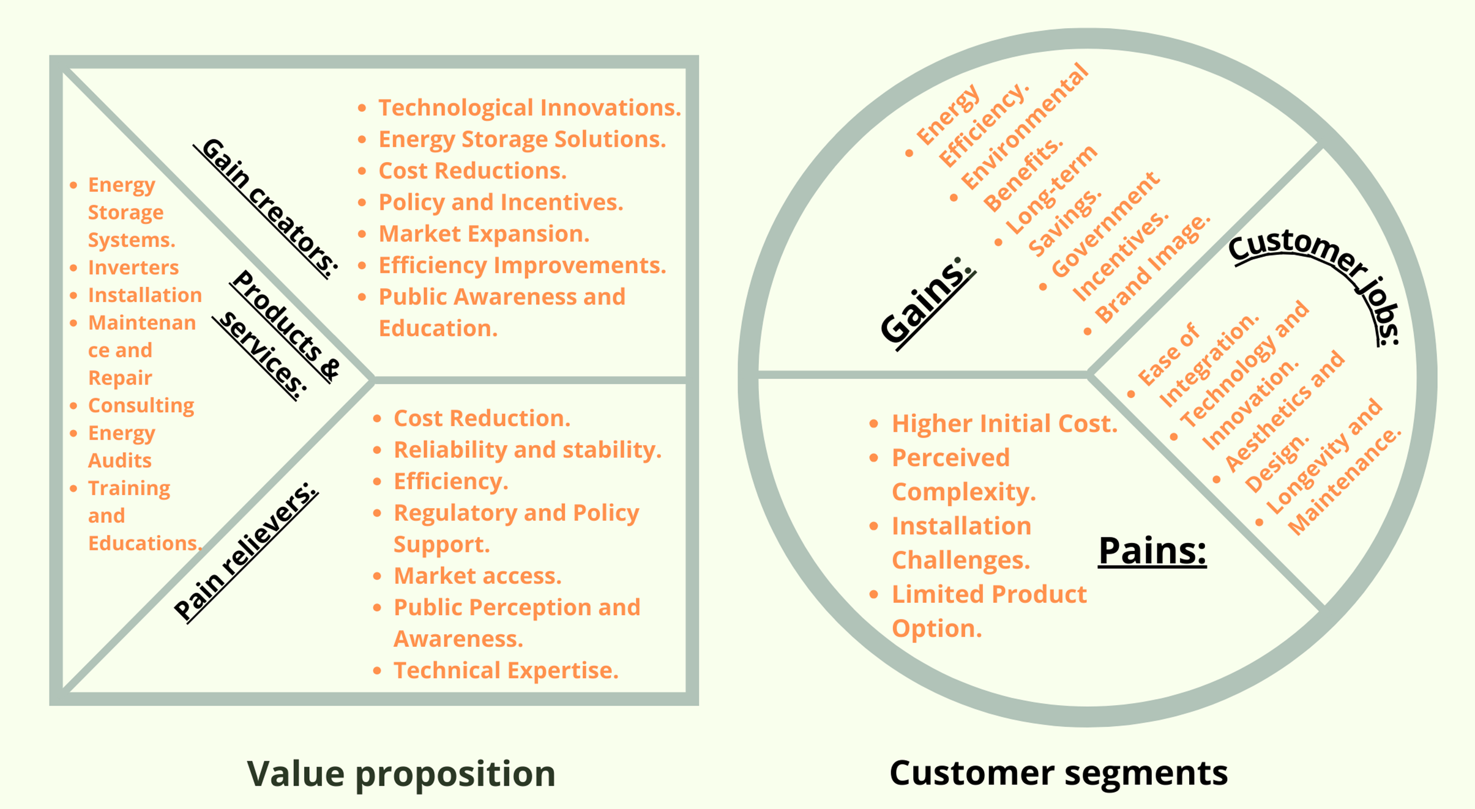

$$\text{Unique} \text{Value} \text{Propagation}\text{ \& }\text{Customer}\text{−}\text{Segment}\text{:}$$

Slide 8
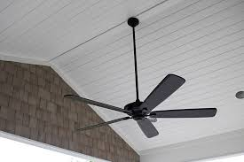
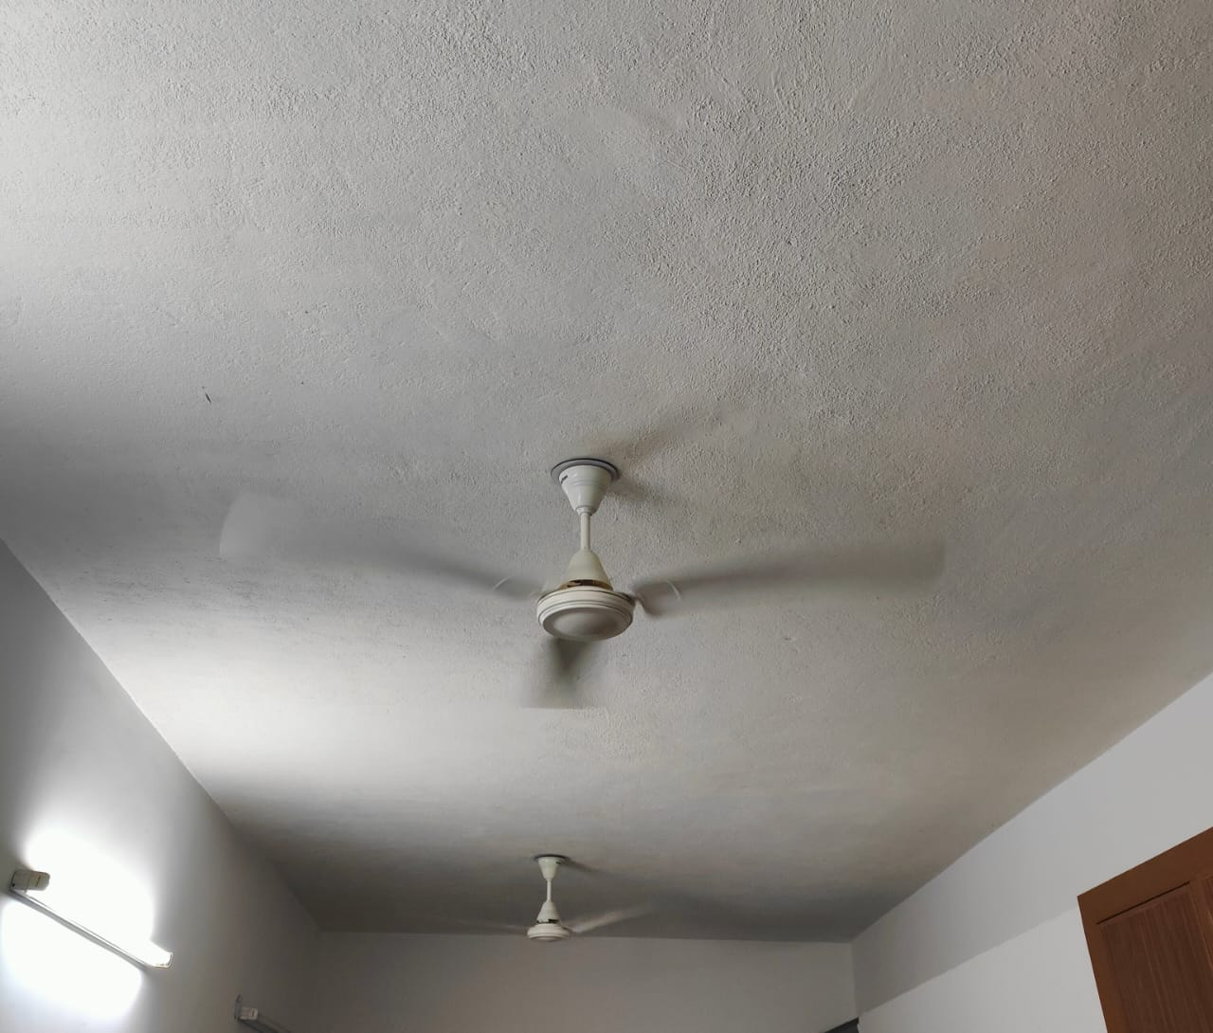
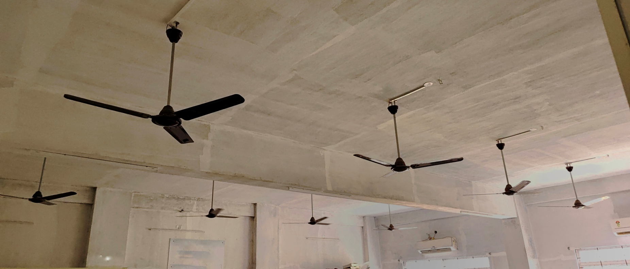
Validation of our Product:
(Product – Market Fit Validation)
This is about ensuring that the product fits into the market in a way that meets customer expectations and can compete effectively. It's about confirming that there is a sustainable business model around your product, and based on our product we had been divided into Three Types :
S.I.P(Single Interface Purpose)
In single user purpose we insert our device in home per if we have single fan we have a alternative model of industrial model in this module, we include battery in the module along with the battery charging unit and the generated energy of these single model is stored in the battery included in the module and the energy is given to the fan from battery module.
M.I.P(Medium Interface Purpose)
In case of houses having multiple fan it might be three - four or more, we may use an inverter hub in these models the module doesn’t includes battery, charging module in model we provides the storing hub. These hub consists of inverter and along a battery the energy generated by these multiple fan is stored in the hub and in the needed situations it is used for AC’S , Large Power needed Electronic Devices.
L.I.P(Large Interface Purpose)
In industrial purpose like if we consider an educational institution it consist of multiple number of fan in multiple number of blocks in different spots at institutional range. These model is similar to module purpose we used in the “Single user purpose” these module doesn’t includes the battery ,charging module . In these industrial module in place of the storing hub we includes the grid technology in these technology we collects the energy generated by the every fan in industry and distributes to the other electrical devices in the industry.

Slide 9
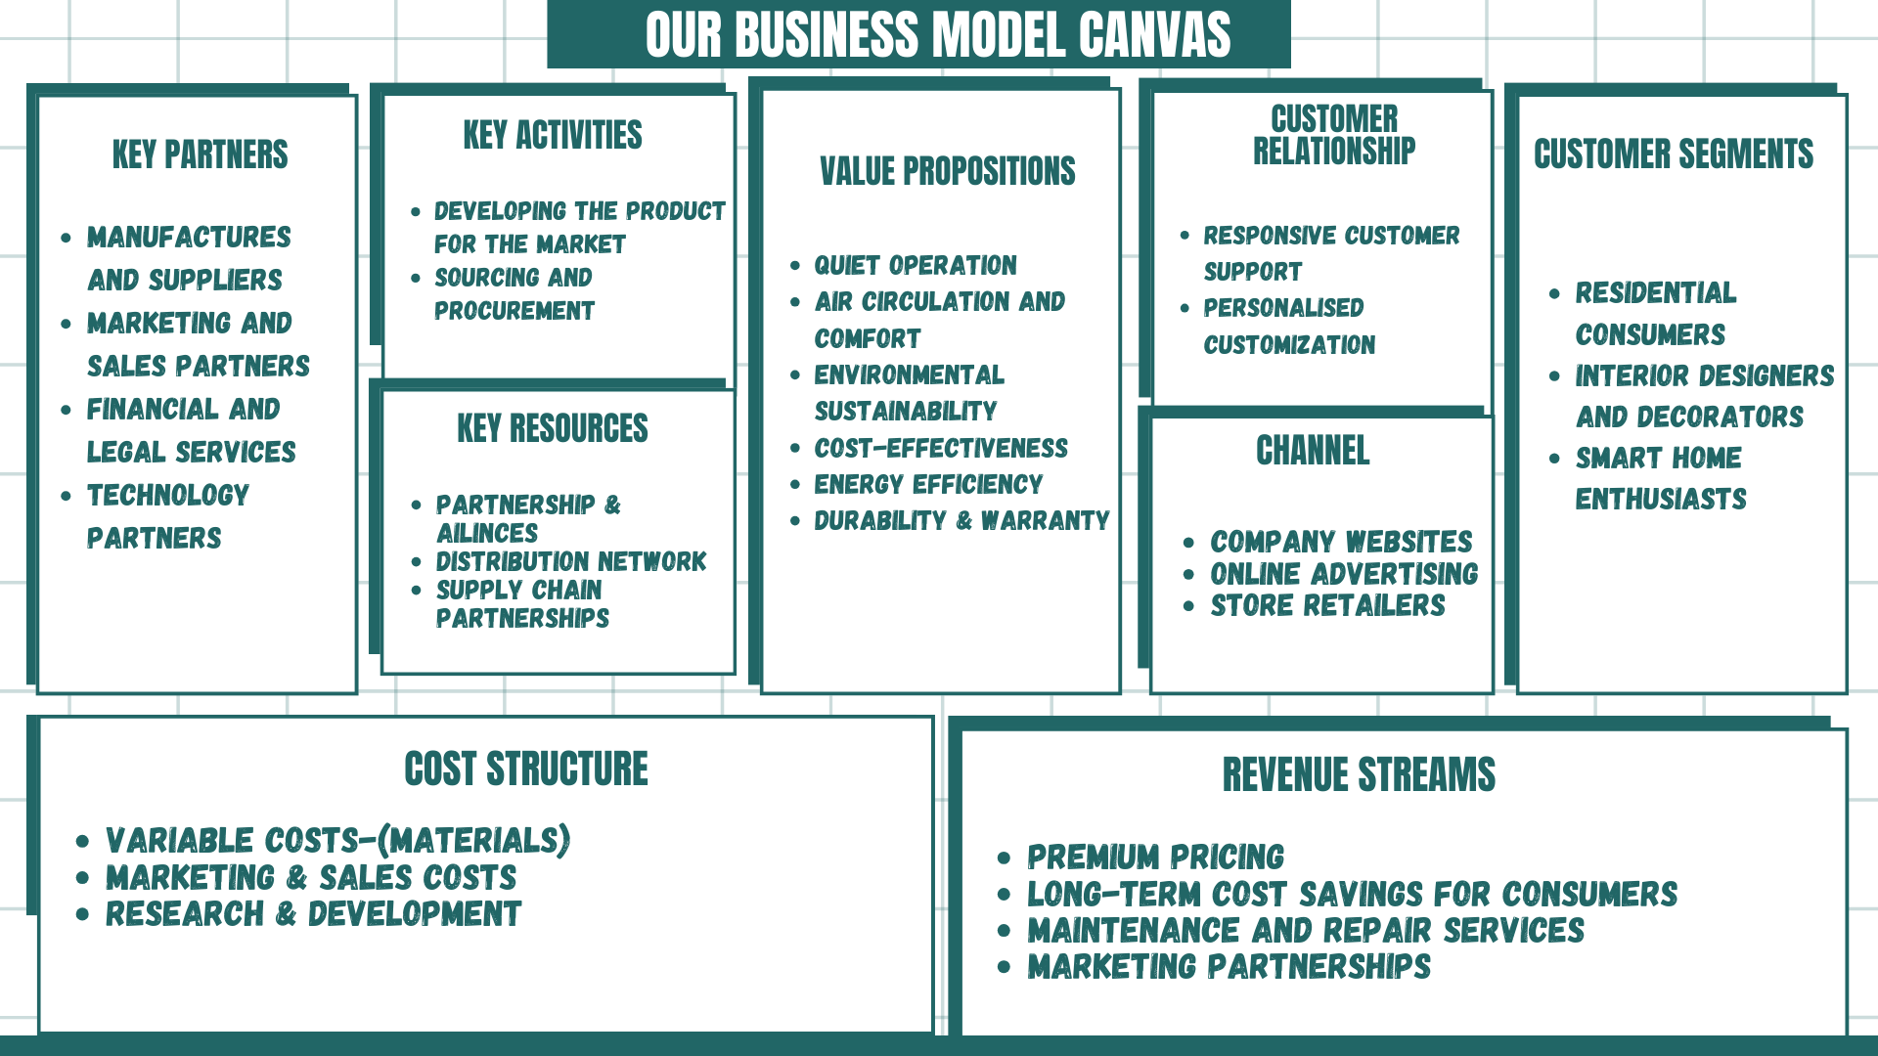
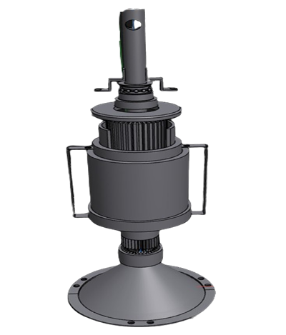
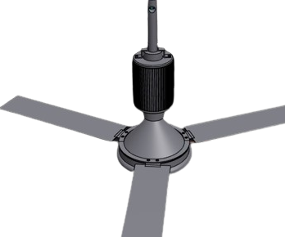
OUR BUSINESS MODEL

Slide 10
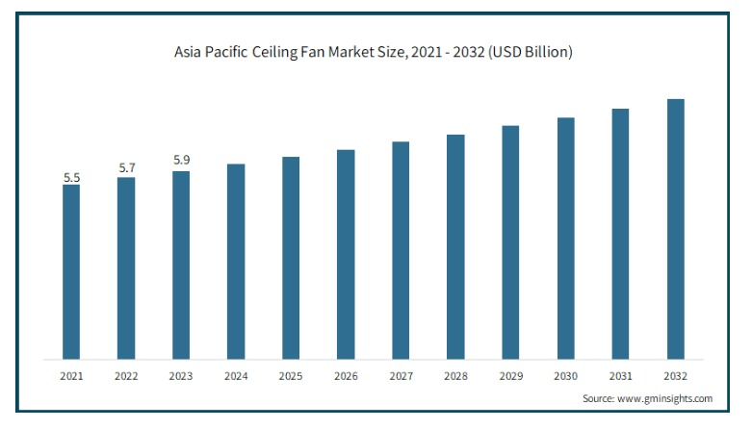
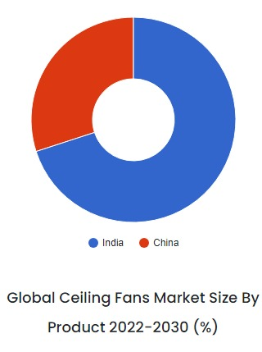
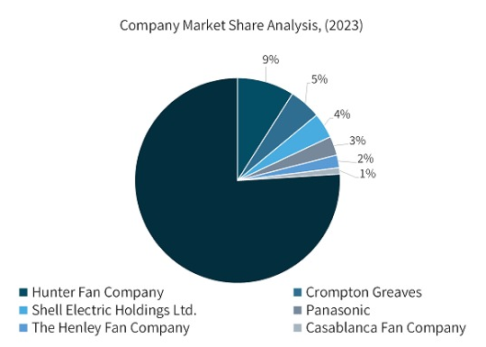

Market Competition:
Market Analysis:
Client’s Satisfaction:
If a client isn't satisfied with a company, it's crucial to address their concerns promptly and professionally. Failing to do so can lead to negative reviews, damaged reputation, and loss of future business opportunities. It's essential for the company to actively listen to the client's feedback, apologize for any shortcomings, and take appropriate steps to rectify the situation. Transparency, empathy, and a genuine commitment to customer satisfaction are key in turning a dissatisfied client's experience into a positive one.
All ceiling fans have an efficiency rating that measures airflow in cubic feet per minute (CFM) per one watt (W) of electrical power used.
The higher the CFM, the more energy-efficient the fan is. The most efficient ceiling fans will have a high-speed airflow rating of over 100 cubic feet per minute per watt.

Slide 11



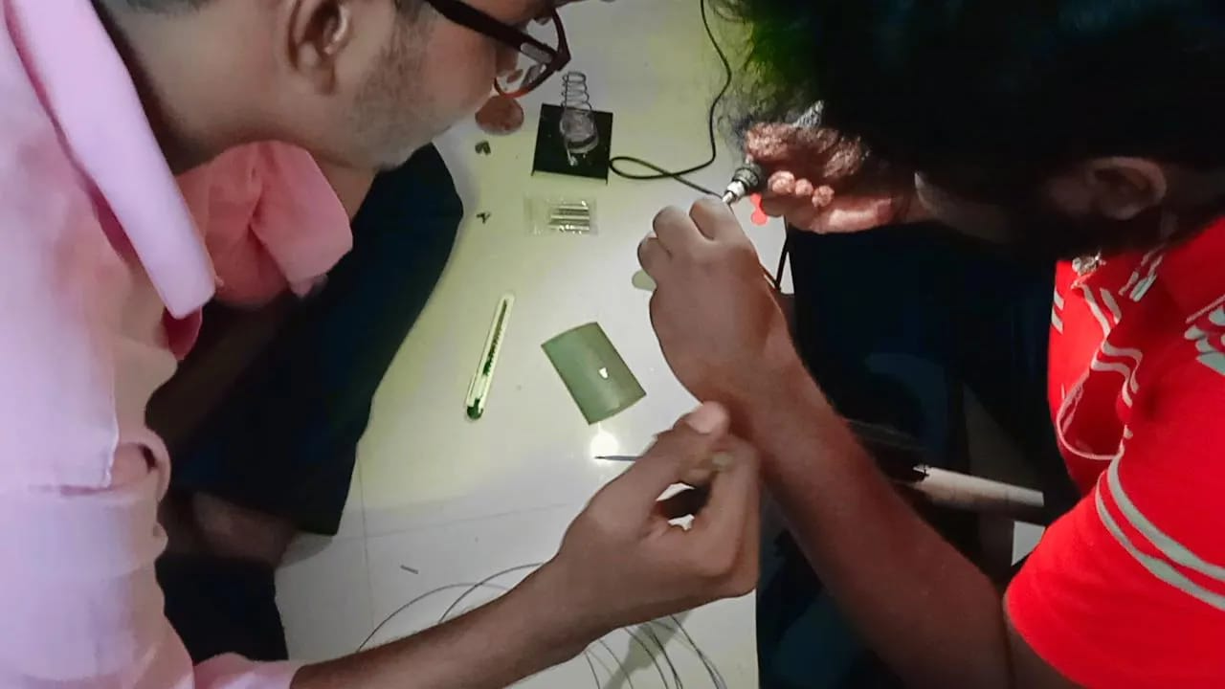

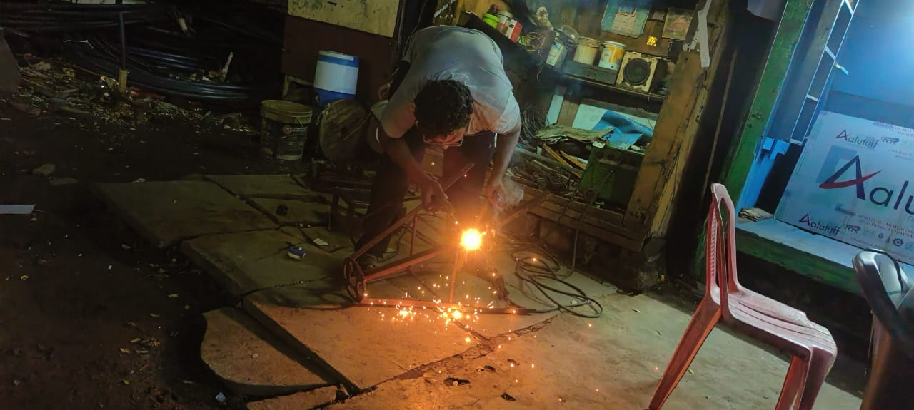
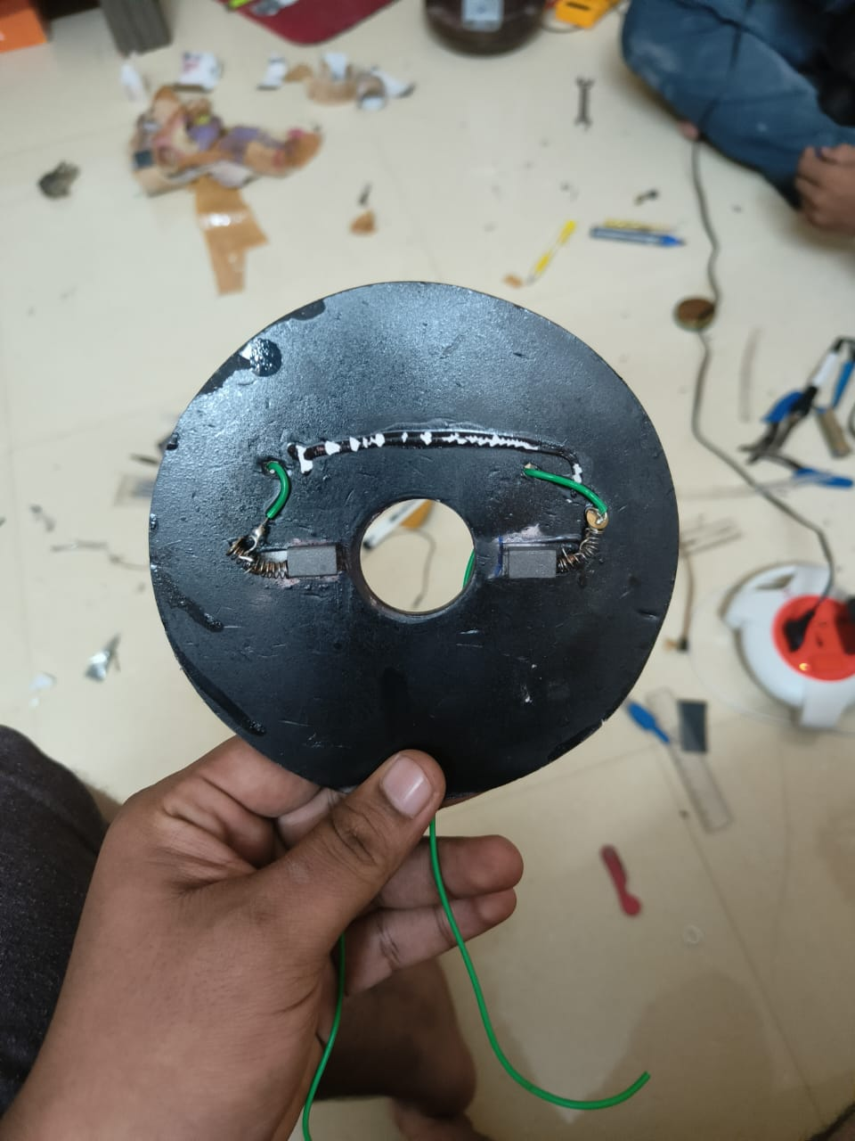
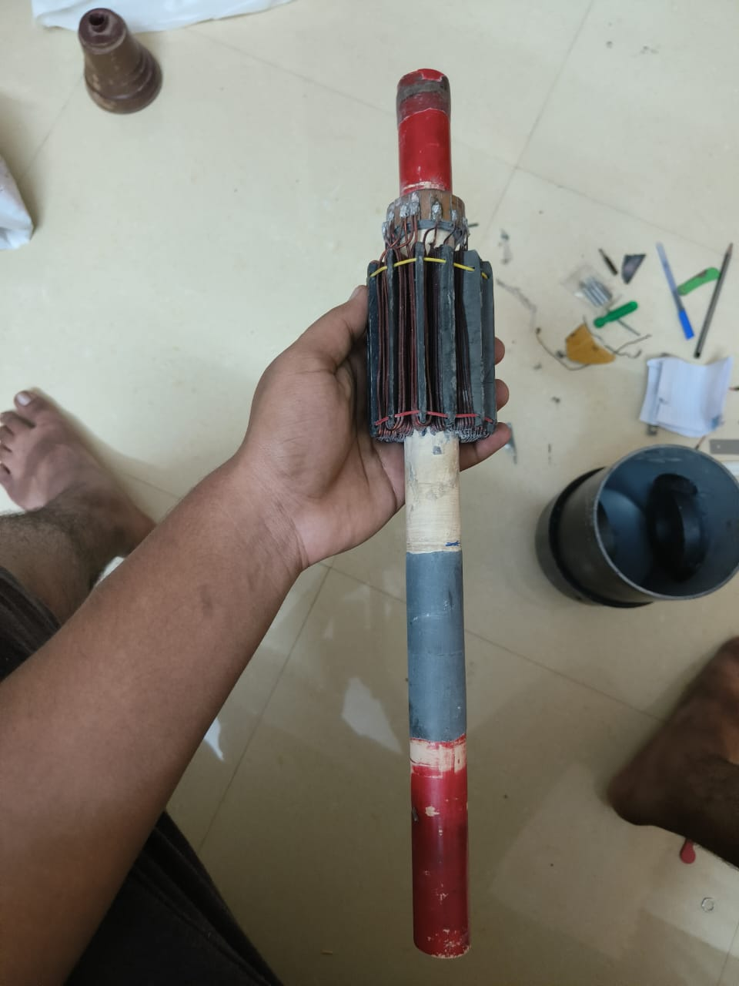
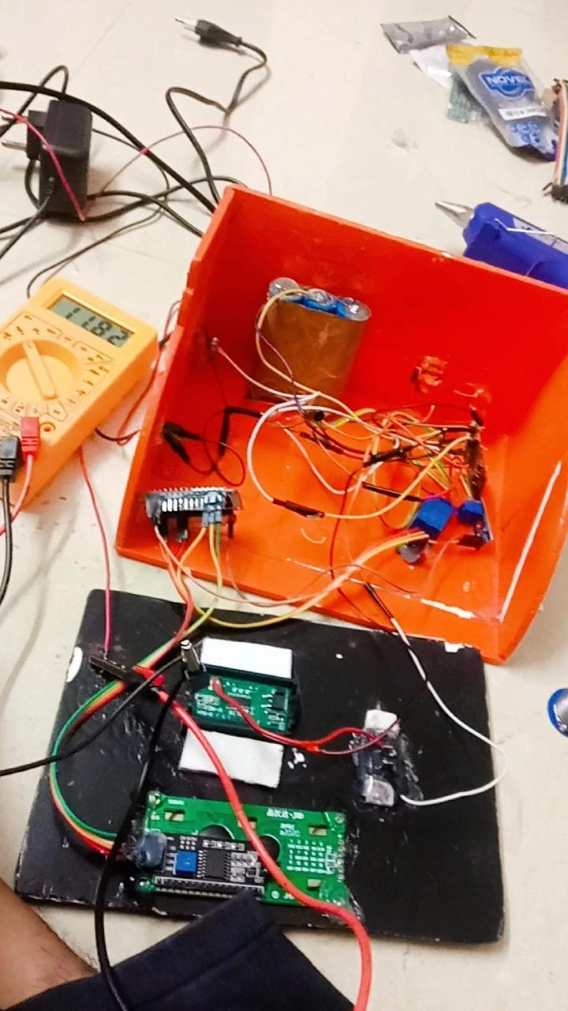
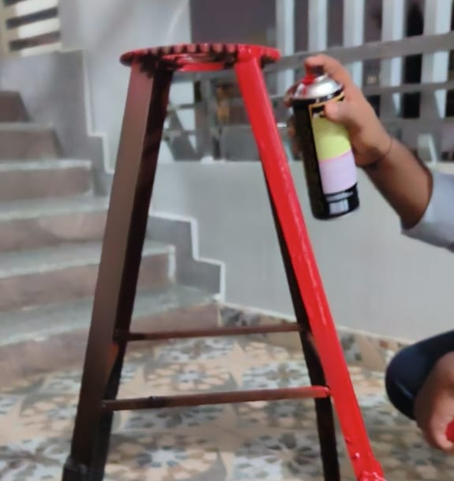
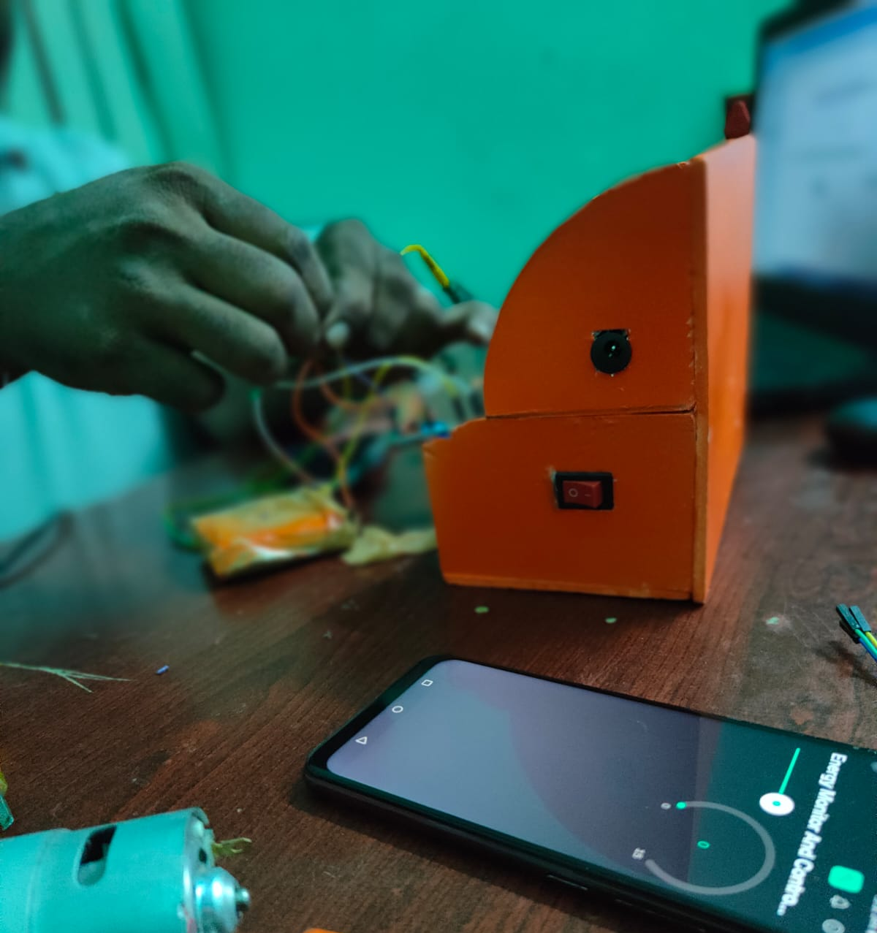
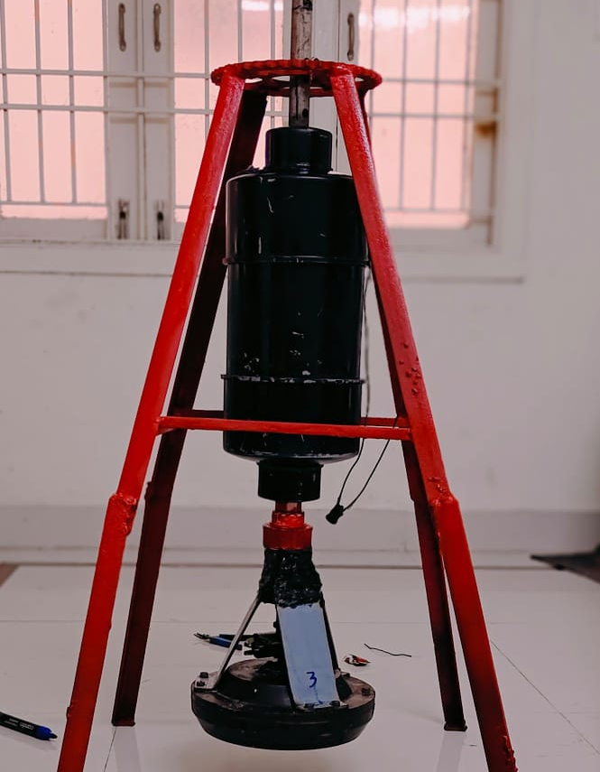
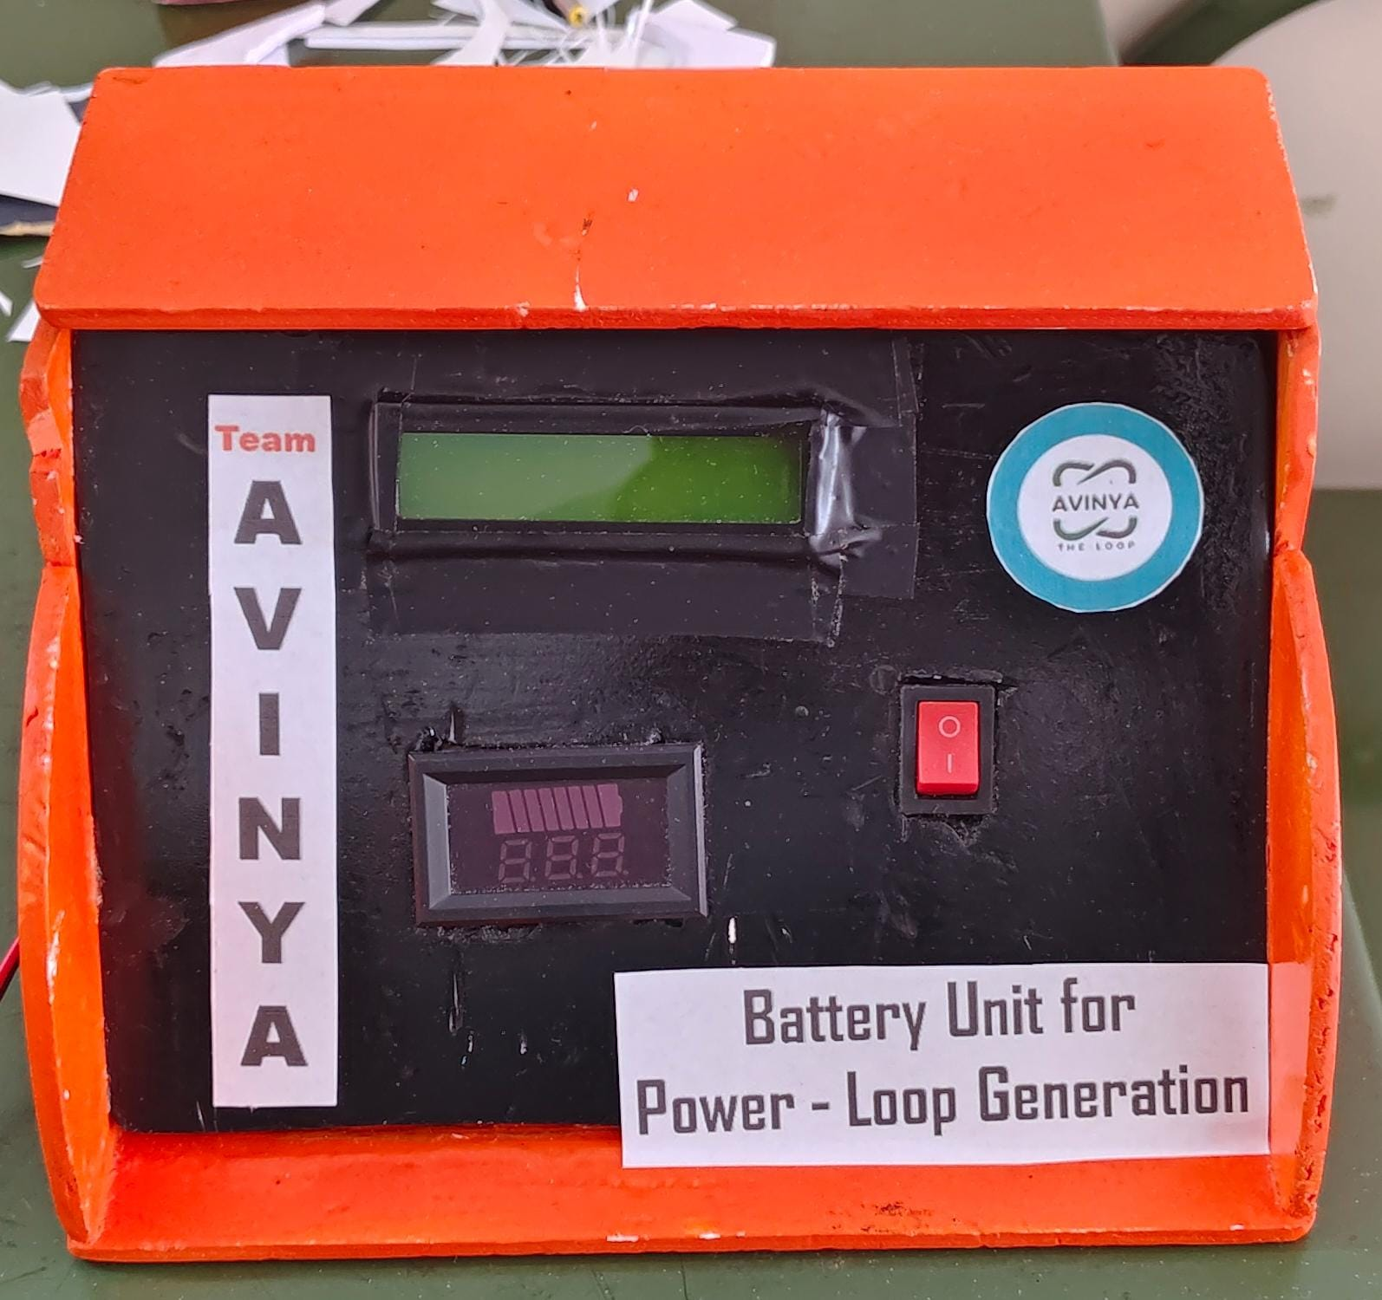
Memories While Making Prototype:

Slide 12
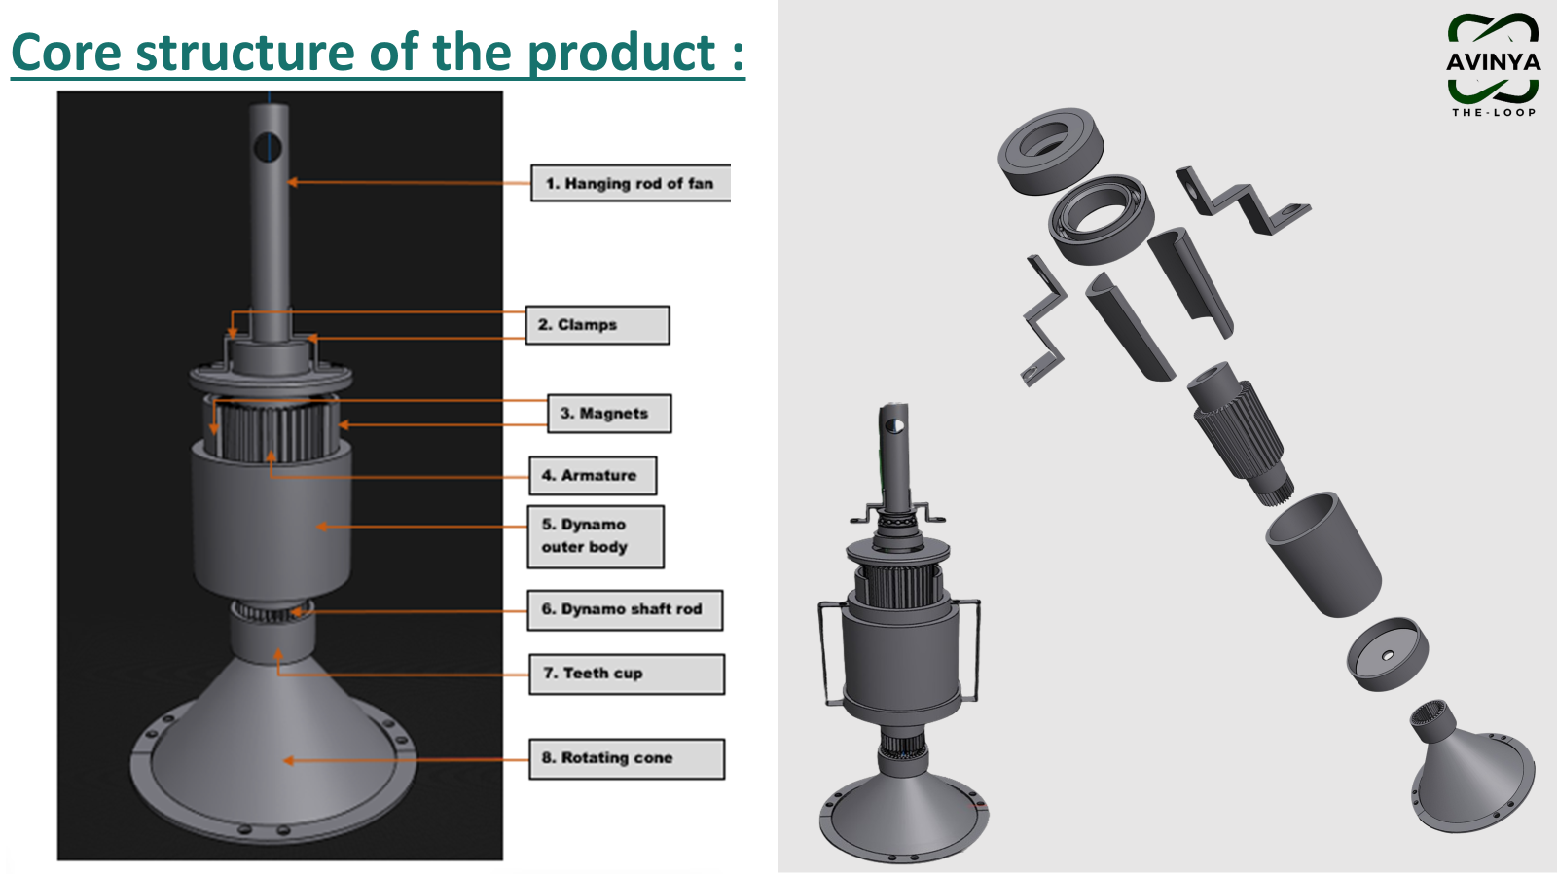

Slide 13
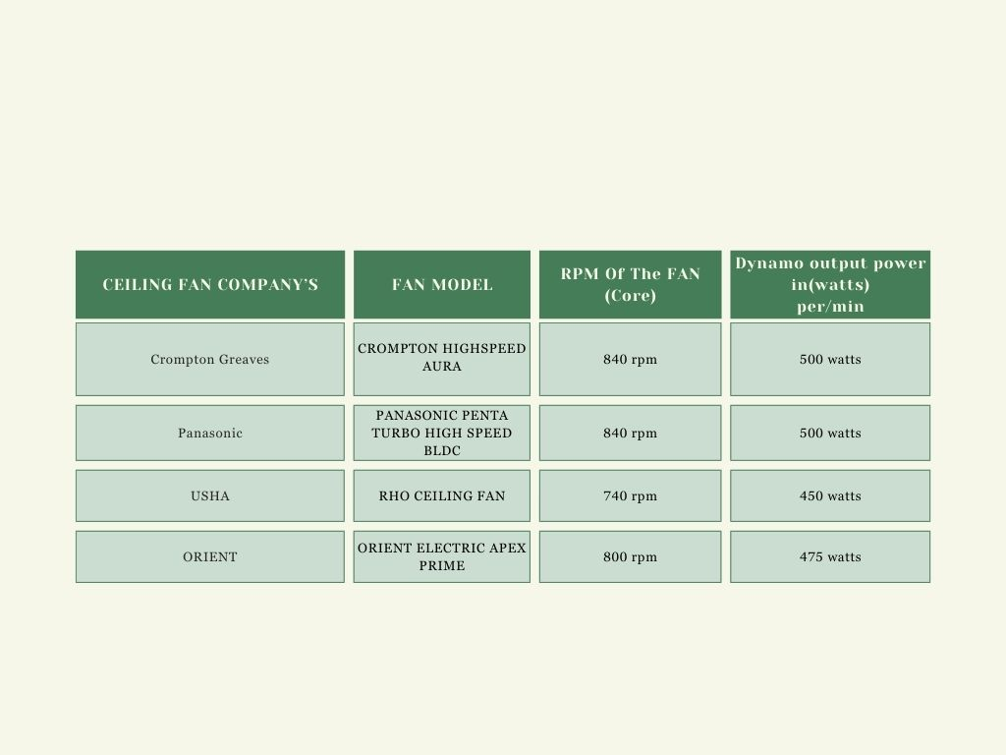
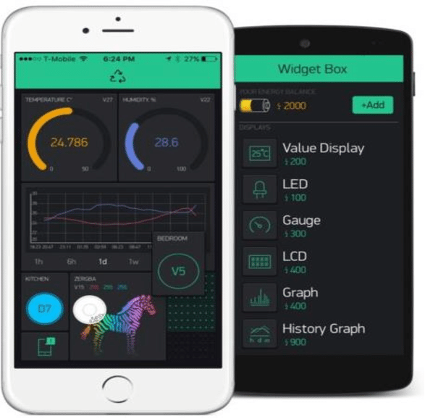
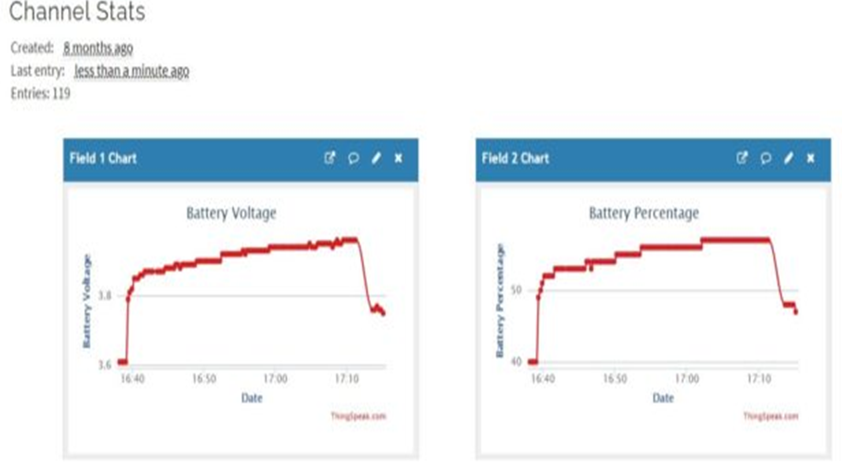
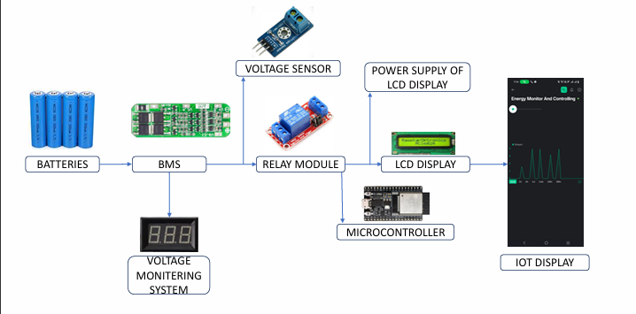
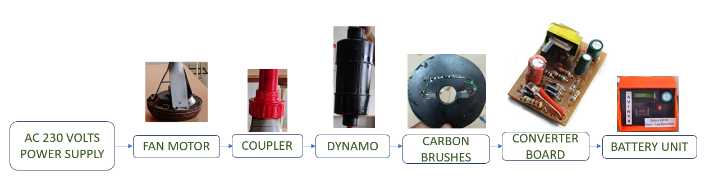
Analytical Calculations of our Product :
Based on the power used of every fan usage of motor is 75W PER -1 hour
IoT Display Unit:
Process Over-View of Power Loop Generation:
Process Over-View of Battery Unit :

Slide 14


ENTER INTO OUR TECH UNIVERSE
DO FOLLOW OUR-SOCIAL MEDIA PAGE
------ SCAN AND CONNECT WITH US --------
THANK YOU
FOR YOUR NICE ATTENTION

